Slide 1
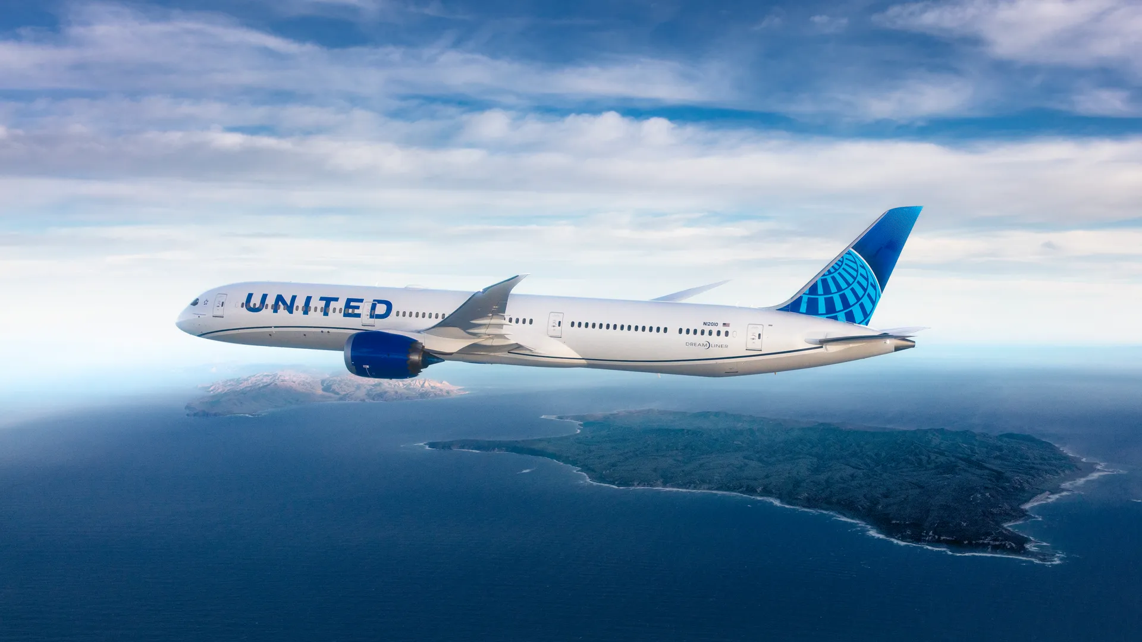

United Airlines
Good Leads the Way
Presented by : Samyak Jain

Slide 2
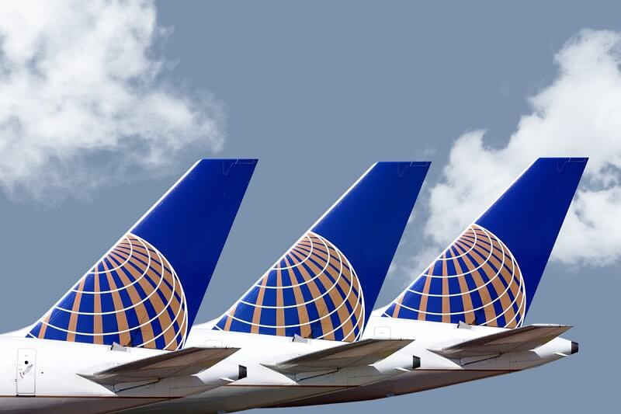
CONTENTS
Recommendations
Approach
Insights
Customer Reviews
Future Prospects
Highlights
HACKATHON
PRESENTATION

Slide 3
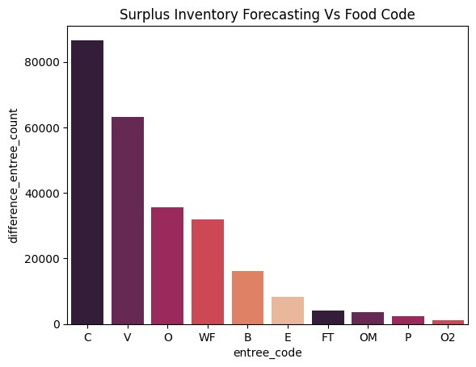
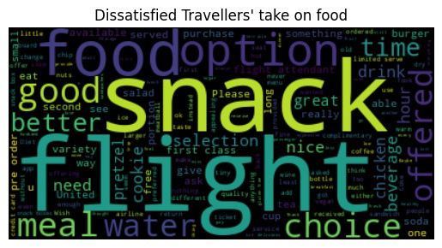
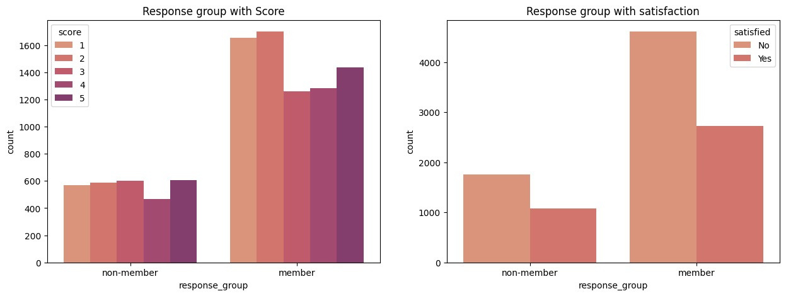
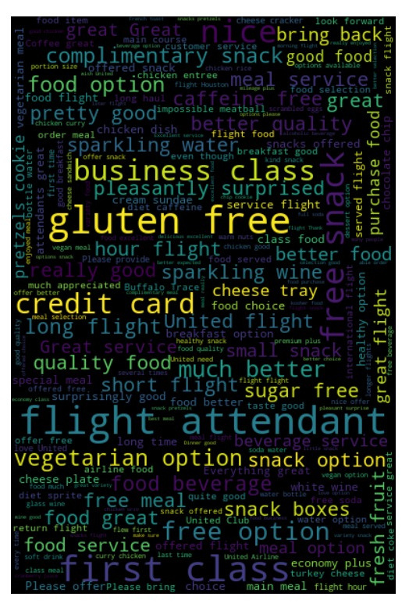
INVENTORY FORECASTING
NOTABLE THINGS TO FOCUS
PROPER AMENITIES
The presented graph depicts the correlation between member/non-member groups and their satisfaction levels. Evidently, a larger proportion of non-members express contentment with the provided F&B services compared to members. This disparity may stem from heightened expectations among United Airlines' paying members for superior, unmet service standards.
The graph illustrates significant forecasted inventory excess compared to actual orders, impacting product prioritization. Glancing at top 10 entrées reveals substantial forecasting discrepancies, potentially depriving customers of preferred choices due to prior allocation.
A proper inventory management can help
It is visible that several words like
- Flight Attendant
- Options
- Snacks
- Choices
- Available
occurs frequently showing that there were not enough options available or flight attendants failed to deliver the orders

Slide 4

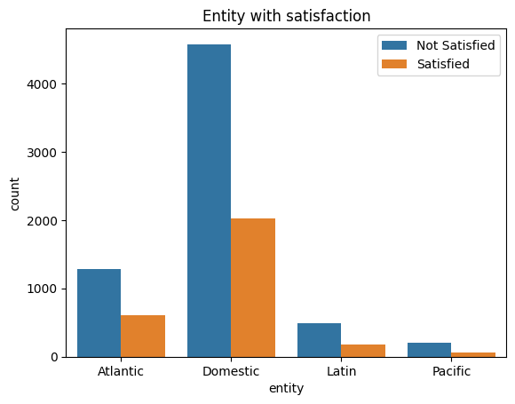
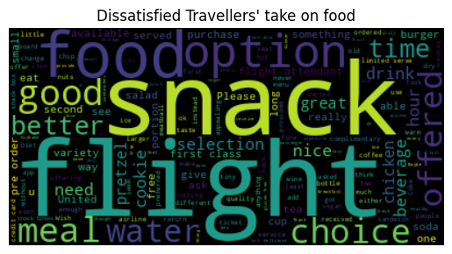

APPROACH
First I analyzed Survey data Inflight Satisfaction Score file, and tried to find some correlation of Score with other attributes.
for example Haul type, Cabin Code, Response Group and Hub-Spoke but no clear correlation was established, even if there was some, the extent for negligible.
Then analyzed the customer review database in which there was no score but customer feedbacks.
I performed Neural Network Processing (NLP) to club the positive and negative feedbacks together.
WordClouds were made to get the words occuring frequently in negative comments so that a better understanding can be made and a hypothesis can be established
Third and the last approach was to club different database using the primary keys to get the insights of possible correlated attributes split in different databases.

Slide 5

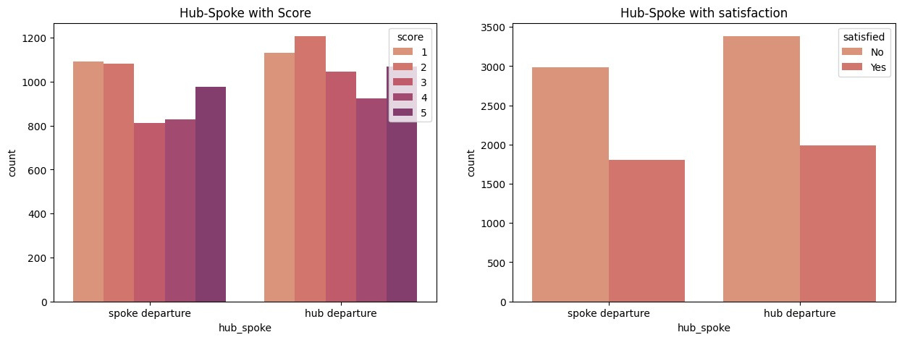
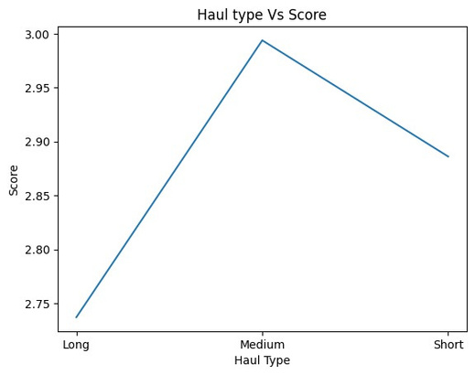
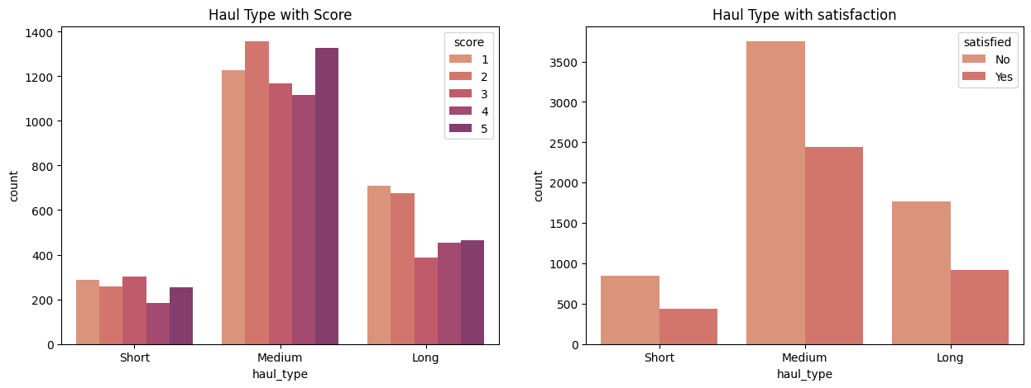
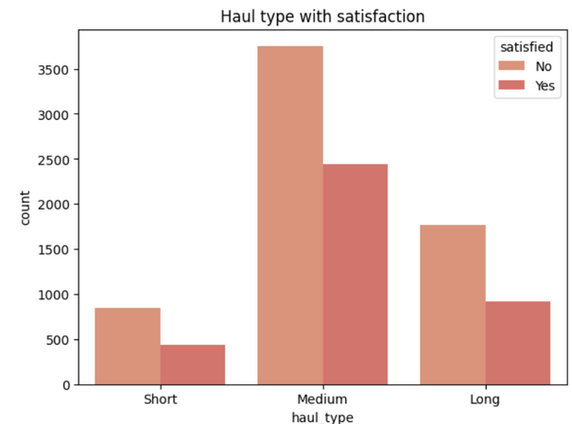
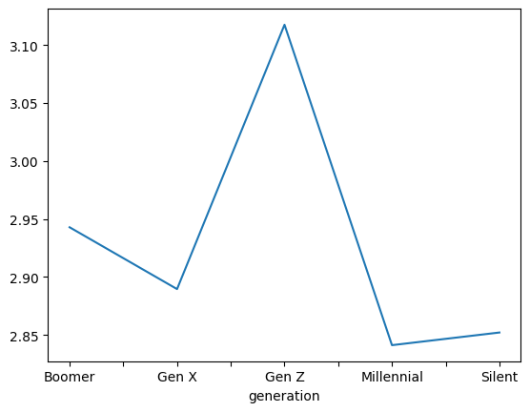
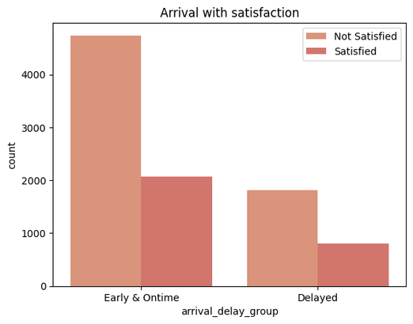
Satisfied
36.1%
Dissatisfied
63.9%
INSIGHTS

Slide 6




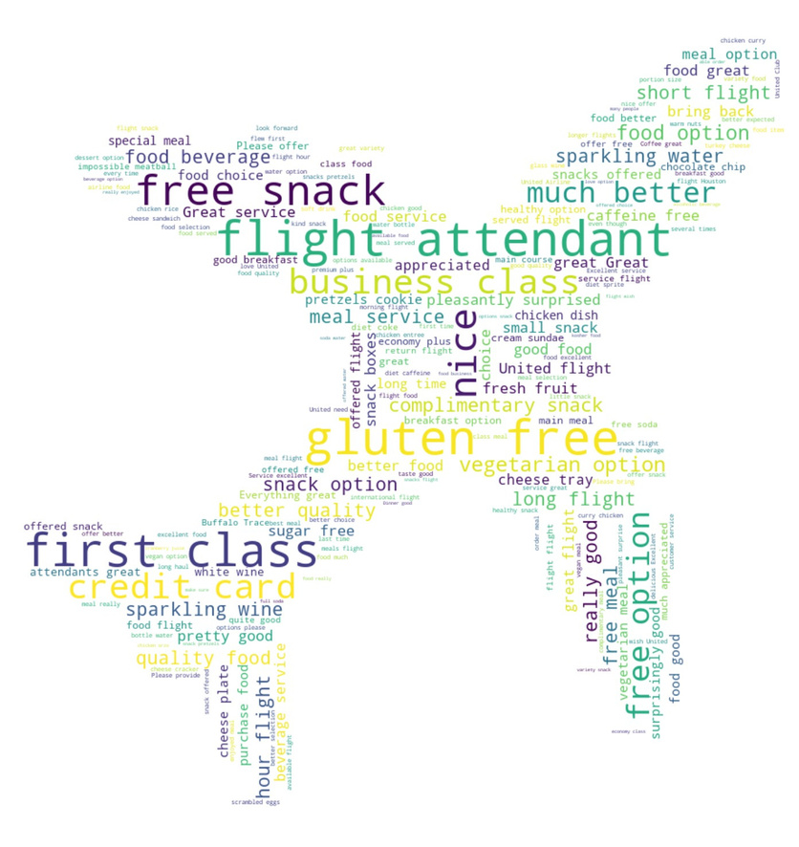
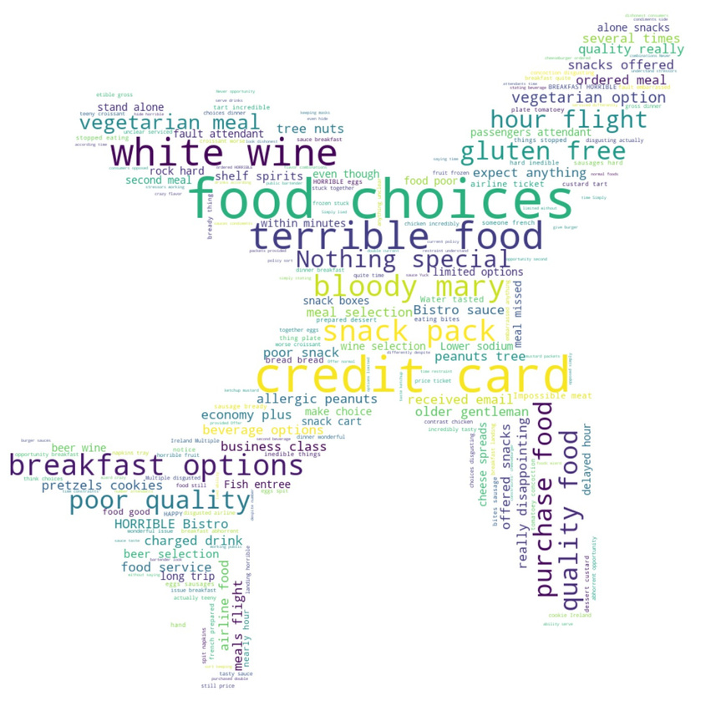




Customer Reviews
HIGHLY POSITIVE
HIGHLY NEGATIVE

Slide 7



FUTURE PROSPECTS
If I was given more time, several weeks, I would study the combined data of all databases to highlight the correlation between satisfaction and other attributes.
A multi-variant time series analysis could be done on inventory data to forecast the demand of Food and Beverages depending on haul_type, fleet_type, date, destination and origin of flight. Resulting in efficient inventory management and better customer satisfaction as more highly demanding products can be swapped with lower demand products
To better visualize the current and future status, top 10 or top 20 flights with highest customer counts can be visualized using plotly express choropleth maps.
By using destination code and origin code, a flight trajectory can be made on a world map. We can even get the insights of a particular flight by hovering mouse on it
@reallygreatsite

Slide 8

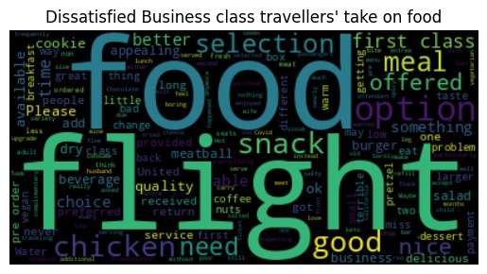
HIGHLIGHTS
It was mentioned in the problem statement that hub flights have higher satisfaction level than spoke flights but as I analysed the data, no correlation was found.
When natural language processing (NLP) was performed on customer feedback, it was found that the problem was more subjective
For instance : The food was served cold, enough options were not available.
Even if we consider every passenger has rationally filled the feedback form, there outcome/ratings might differ because multipltle entries from different passengers belonged to the same flight .
It was seen that member of United Airlines were less satisfied as compared to the non members. Similar trend was seen in economy, business and premium class. This could be due to higher expectations of high spending customers.

